Slide 1
Error Code Small Group
AIRA

Slide 2
Group Setup
Slack
Github

Slide 3
Discussion
Jane Lammers

Slide 4
Scope
In Scope
Looking at PID to start with
ERR-5: Adding new codes to list
Minor changes to existing codes possible
Most common and fatal errors Need this information from the group.
Criteria for adding new codes (how specific / generic they should be)
Categorization, Tagging?
ERR-2 Could be used to provide context for generic concepts
Might be a strategy to combine specific / generic, levels, use both
Meta Information
Cross linking with Data Validation Guide (combined document) - Link to specific section in a guide, might also be conformance statement in IG
Flag items that are clinically possible so should not ever be hard errors
Perhaps provide guidance on valid/invalid severity codes?
Actor/Action – could get some feedback from IIP
Look at Actor terms/types, need to make sure the text makes sense for clinician?
ERR-9 Inform Person Indicator – if we could categorize we could message this, come up with suggested values (Stretch goal, if we have time)
Future Work
ERR-7 Diagnostic Information
ERR-8 User Message
QBP related errors
Out of Scope
ERR-4 Severity – determined by IIS at run time
ERR-3 HL7 Error Code – set by HL7, we can’t change it
Notes:
The champion should propose to the group an initial scope. The group should discuss, but this does not have to be finalized in the Kick Off meeting. If the discussion lasts for more than 10 minutes then the discussion will continue on the first call of the group. It usually takes two meetings to get the scope set for sure.

Slide 5
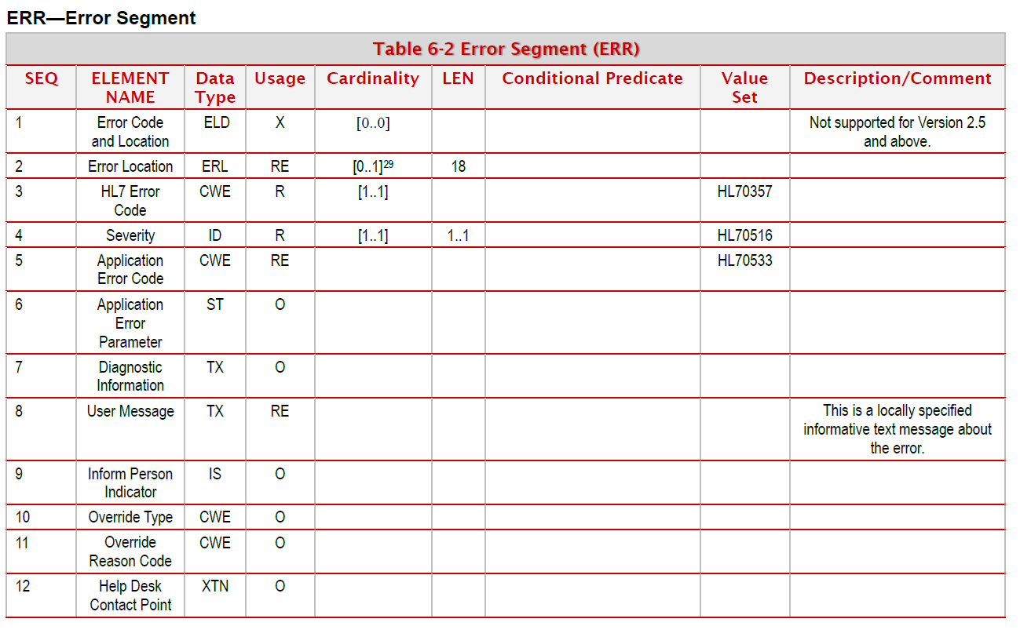

Slide 6
Task Participants
Guidance Document | Test Cases | Technical Demonstrations
Chrissy Miner Craig Newman Maia Ouderkirk Danny Wise Kevin Snow Stephen Hill | Jane Lammers Jason Suchon Heather Crawford Lori Reed-Fourquet Nathan Bunker

Slide 7
Deliverables
Area | Deliverable | Notes
Guidance | Updated Guidance Document Need guidance on what needs to be added Updated spreadsheet of codes Focus on common fatal | All: Please read guide before next call Send most common/fatal errors
Test Cases | AART has test cases Work from Google spreadsheet Update and add items Prioritize (high, medium, low) | Will need to add columns to spreadsheet to coordinate progress
Software Demonstration | MQE Tool Envision WebIZ Error Analysis Compare ACKs, make them more consistent EHR Generic Requirements for ACK processing

Slide 8
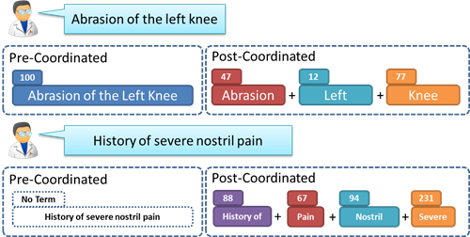
Pre vs Post Coordination
Pre-coordination
ERR-5 = nnnnN^Patient First Name Missing^HL70533
Post-coordination
ERR-2 = PID^1^5^2
ERR-5 = 7^Required Data Missing^HL70533

Slide 9
Pre vs Post Coordination
 | Benefits | Drawbacks
Pre-coordinated | Can write actor/action specific to issue Error code label can indicate specific issue, user doesn’t have to interpret HL7 reference | Will require ~ 250 more new codes More than one way to communicate the same concept Receivers will still need to be able to read ERR-2 for context if IIS sends more general code
Post-coordinated | Won’t duplicate data already sent in ERR-2 Reduces the need to enumerate all possibilities Reduces number of codes (~100 instead of ~400) | Receivers will need to read ERR-2 to understand the concept for the error Can’t give specific guidance for common situations Doesn’t match view in IIS that sees these as separate issues

Slide 10
HL7 vs Data Quality Issues
HL7 Messaging Level
Problem with construction of HL7 message
IIS may or may not accept the message
Most issues are resolved in interface development
Data Quality Level
Problem with data in the message
IIS decides on final severity for each submitter
Issues often resolved by front-line staff or clinicians

Slide 11
Guidance for Creating Codes
Need rules for making new codes
Publications that support adding new codes:
Business Rule defined in a data quality guide
Inventory Deduction, is this in the consolidated guide?
CDC Endorsed Data Elements?
Could be used if we pre-coordinate concepts
Sources that are not recommended as primary sources:
HL7 messaging issues? (Leave this to be post-coordinated?)
Numbered constraints in the IG?
~70 constraints in 1.5 (e.g. IZ22, IZ33) HL7 2.8.2 too?
Data Type validation – HL7 guide
IIS practice?

Slide 12
Guidance for Creating Codes
Additional rules:
Description of rule should not indicate severity of error:
This is not ideal: “7^Required Data Missing”
This is better: “7^Data Missing” with ERR-4 = E or W
Should not indicate states of processing using ERR-5
Not ideal: “Patient First Name is Missing, Record Rejected”
Better: “Patient First Name is Missing”, MSA-1 = E, ERR-4 = E

Slide 13
Guidance for Using Codes
IIS should select most specific code possible
Several concepts in IIS might map to the same specific code
IIS should not expect one-to-one match with national codes
IIS may send internal code in second triplet in ERR-5
May be more specific and have additional detail than code
IIS can give additional detail in other fields in the same segment
Don’t send the same concept in two ERR segments, just choose the best

Slide 14
Review of Document
Reactions from the group

